Slide 1
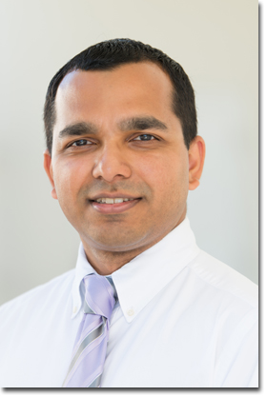
Parmanan Deopersad - PwC Cayman Director Telephone: +1 (345) 914 8721 Cellphone: +1 (345) 938 8721 E-mail: p.deopersad@ky.pwc.com
Experience and expertise Parmanan is director of PwC Cayman’s financial statement preparation services group. He has been with PwC for more than 15 years and has more than 10 years of asset management assurance experience with a variety of hedge fund structures and strategies. He has extensive experience in the application of both US GAAP and IFRS and is co-author of PwC’s global Illustrative IFRS Financial Statements for Investment Funds. Parmanan is a member of the main committee of PwC’s global IFRS asset management industry accounting group and also sits on PwC Cayman’s technical committee.
Qualifications and memberships Parmanan is a fellow of the Association of Chartered Certified Accountants and member of the Cayman Islands Institute of Professional Accountants.

