Slide 1
Introduction to the world of Blockchain
March 14, 2019

Slide 2
Agenda:
Intro to Blockchain
Current trends and topics
The future
Q & A

Slide 3
So where did it all begin?

Slide 4
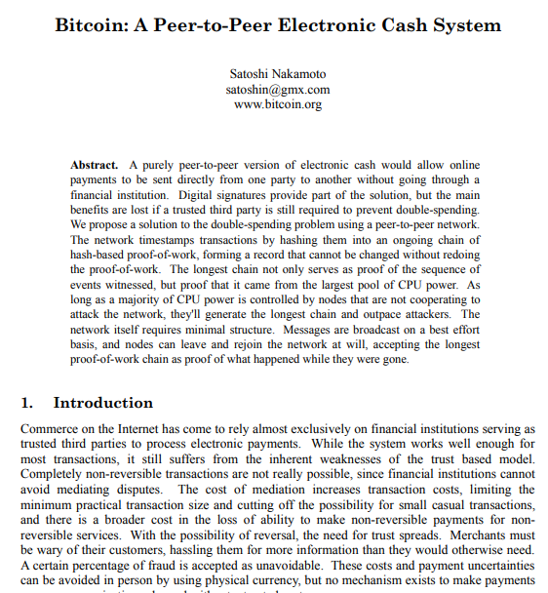
Bitcoin
Source: https://bitcoin.org/bitcoin.pdf
Notes:
Read it – it’s only 9 pages
published on 31 October 2008
January 2009, the bitcoin network came into existence after Satoshi Nakamoto mined the first ever block on the chain, known as the genesis block
January 12th, 2009 transferred 10 btc to Hal Finney

Slide 5
The early attempts
Reusable Proof of Work
Hal Finney
HashCash
Dr. Adam Back
B-Money
Wei Dai
Bitgold
Nick Szabo
Bitcoin
Satoshi Nakamoto
1997
1998
2004
2005
2008
Notes:
HashCash – at its essence anti-spam mechanism adding time and computational power cost to sending emails – therefore making spam uneconomical. Sender had to prove had expended computational power before allowed to create stamp in header of email. (Similar to POW)
B-Money - two methods of maintaining the transaction data;
a) every participant to the network would maintain a separate database of how much money belongs to users and,
b) all records are kept by a specific group of users - custody over the records are incentivised to be honest because they have deposited their own money into a special account and stand to lose it if they are not.
Reusable Proof of Work - proof-of-work string of a given difficulty, signed by his private key. The server then registers that token as belonging to the signing key. The client can then give the token to another key by signing a transfer order to a public key. – However was centralized on trusted server
Bitgold - describes a system for the decentralized creation of unforgeable proof of work chains
Byzantine-resilient peer-to-peer method
owever, this Byzantine method relies on a quorum of network addresses rather than a quorum of (hash) computing power, so unlike bitcoin it is vulnerable to Sybil attacks

Slide 6
So what is a Blockchain?

Slide 7
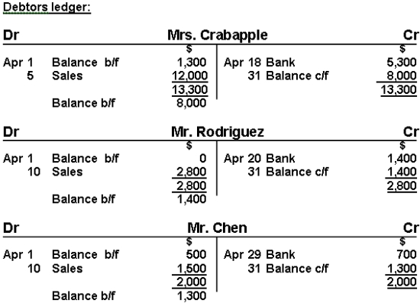
It’s a ledger:
Notes:
At its core a blockchain is a ledger of transaction.
Not only used for accounting.

Slide 8
Why is it so powerful?

Slide 9
Peer to peer sharing:

Slide 10
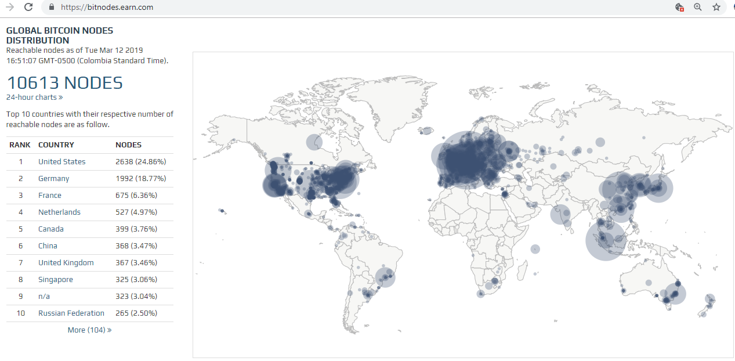
Peer to peer sharing:

Slide 11
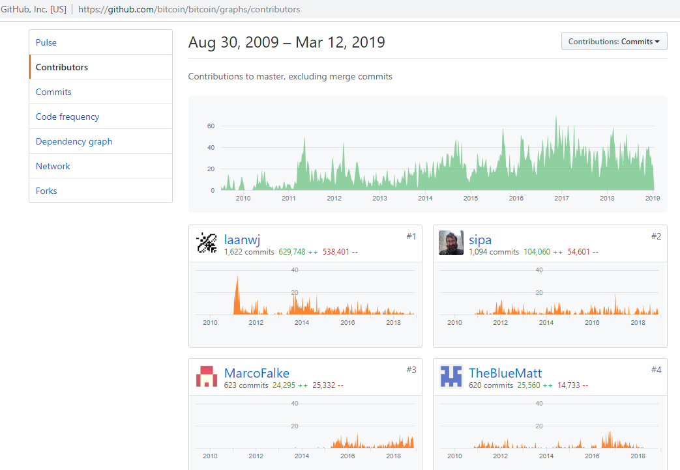
Open source software development:

Slide 12
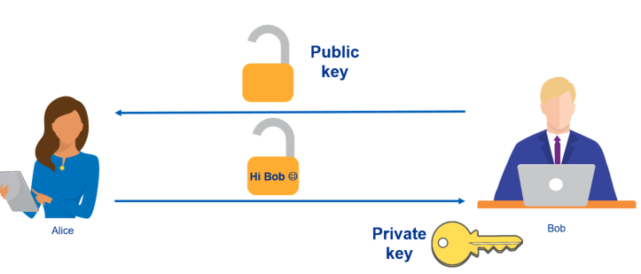
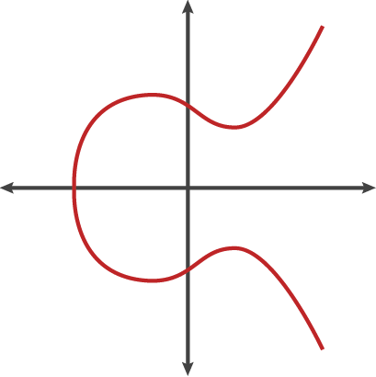
Encryption:

Slide 13
How does it work?

Slide 14
Alice wants to send Bob some Bitcoin?
Alice
Bob
Notes:
Miners verify transactions by making sure the signature is correct and then add the transaction to the block.

Slide 15
For Bitcoin
Private Key
Public key
Address
Elliptic Curve Multiplication
Hashing Function
1L1zx2dSZDswngefGir456hXdEUuzxkhL3
=
=
Think of it similar to a bank account:
PIN
Account number
Notes:
Public key is derived from the private key
Private key is used to sign transactions
Public key is used to receive funds
There is a mathematical relationship between the public and the private key that allows the private key to be used to generate signatures on messages. This signature can be validated against the public key without revealing the private key.
These functions can not be reversed – You can not get my private key by reversing the Public key calculation

Slide 16
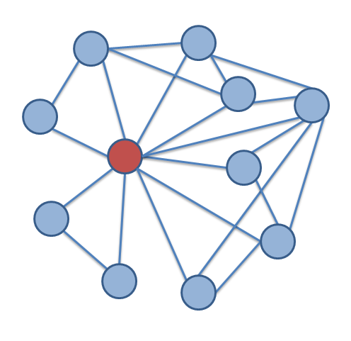
Back to Alice and Bob
Alice
Transaction hash:
Transaction detail get signed with Alice’s private key :Send BTC1 to Bob on 14 March 2019 at 9:20
8a2def19d05ec2debdbd9619bcaa9909d4f763ad44bc73b95cc227a504ba6a4e

Slide 17
Who verifies this transaction?
Miners
Alice
Bob
Notes:
Miners verify transactions by making sure the signature is correct and then add the transaction to the block.

Slide 18
Proof of Work (POW)
Blockchain
Block
Our block
Memory pool of unconfirmed transaction
Miners verify and bundle transactions in block
POW
Block n + 5
Block n + 4
Block n + 3
Block n + 2
Block n + 1
87Hunfiusdfh
LJaHF87jhok
Kjsoin8akjhdf
Akjhf Y&akjdj
KJHfu98ahiuna87IUHoauhfo
Block n
Genesis block
Notes:
miners race to bundle all the pending transactions (including bobs) in the network and mine the resulting block by varying the nonce. In particular, the miners create a hash of the block, and if the hash does not begin with a particular number of zeros, the hash function is rerun using a new random number (i.e., the nonce). The required hash value must have a certain but arbitrary number of zeros at the beginning. It is unpredictable which nonce will generate the required hash with a correct number of zeros, so the miners have to keep trying by using different nonces to find the desired hash value. When the miner finds a hash value with the correct number of zeros (i.e., the discovered value is lower than target value), the discovery is announced in the network, and both the Bob and the Alice will also receive a confirmation about the successful transaction. Other miners communicate their acceptance, and they turn their attention to discover the next block in the network.
The goal is now to find a value for the nonce that results in a block header hash that is less than the target. The mining node will need to test billions or trillions of nonce values before a nonce is found that satisfies the requirement.

Slide 19
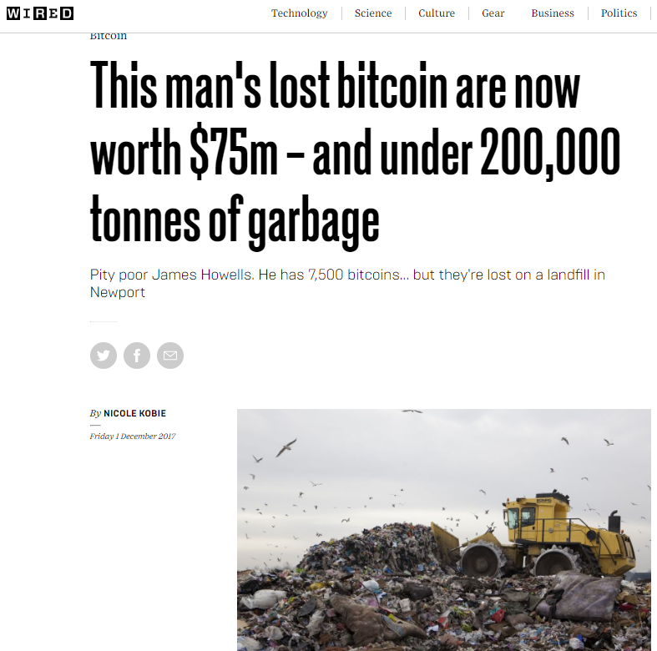
Mining Fee
Mining fee per block = BTC 12.5 + Tx fees
Reward halves every 210,000 blocks / 4 years (May 2020)
Difficulty adjustment every 2016 blocks keep to 10 mins
Caped at 21,000,000 coins
Mine final coins 2140
Total actual supply will be less

Slide 20
Blockchain:
Prev Hash
Prev Hash
Prev Hash
Prev Hash
Prev Hash
1
2
3
4
1
2
3
4
1
2
3
4
1
2
3
4
1
2
3
4
1
2
5
4
Hash
Hash
Hash
Hash
Hash

Slide 21
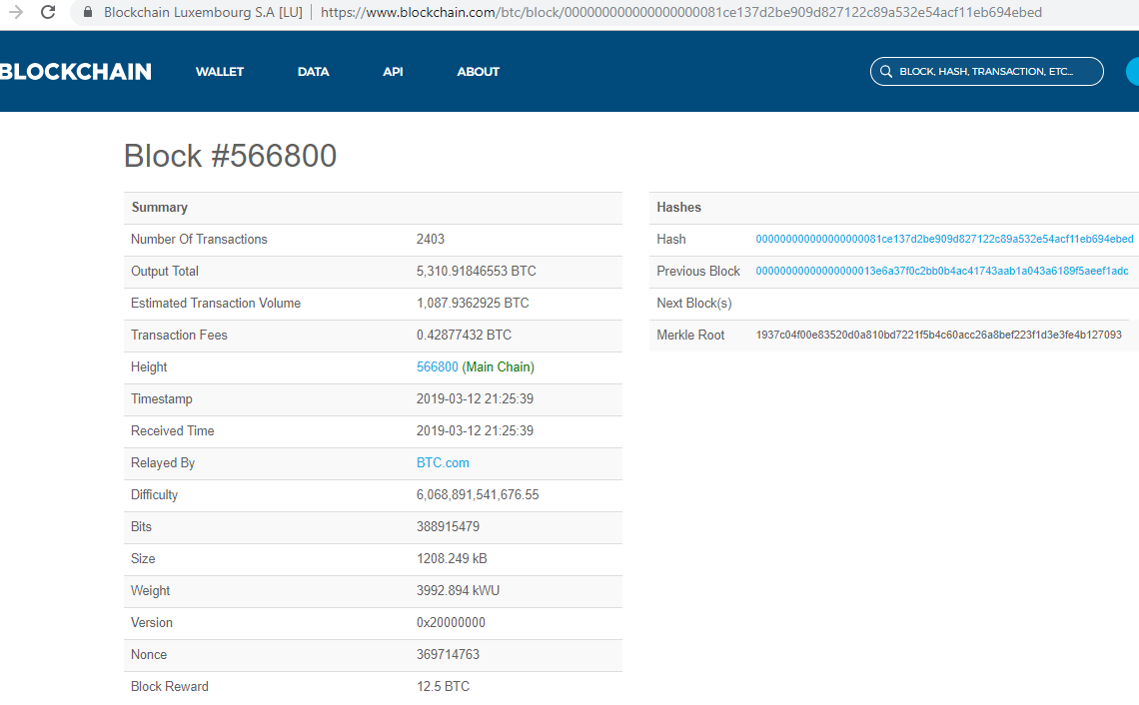
Final Transaction:

Slide 22
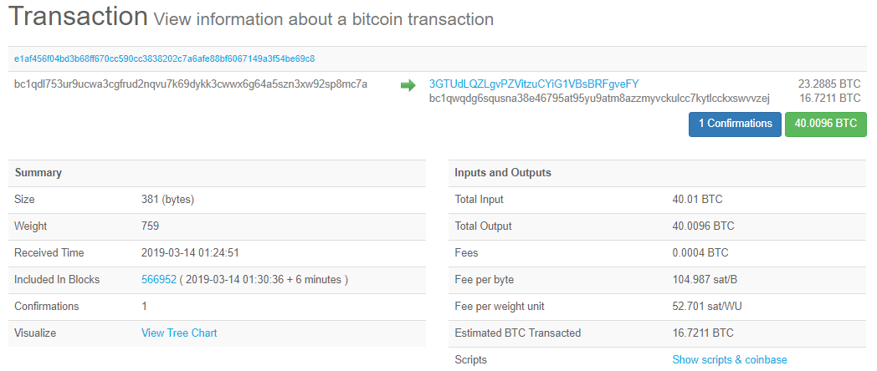
Final Transaction:

Slide 23
Why does all of this matter?

Slide 24
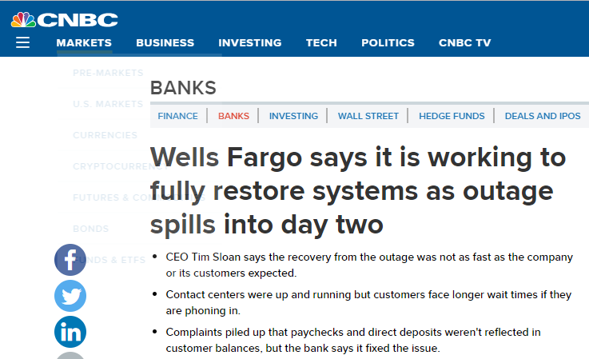
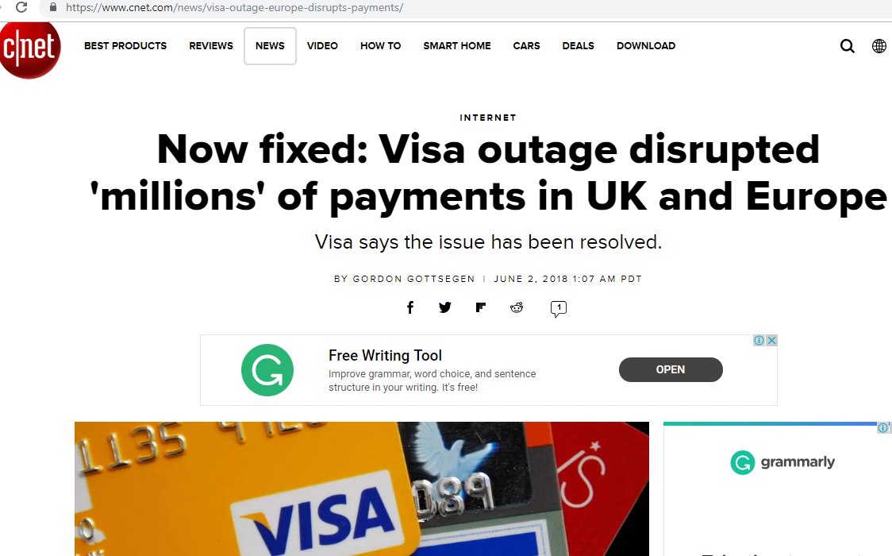

Slide 25
Current trends and topics

Slide 26
Rise of the stable coins

Slide 27
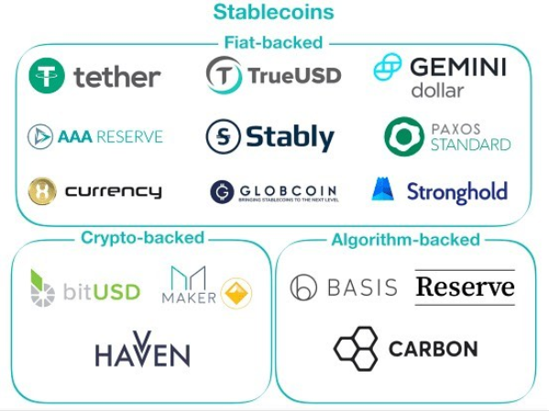
Rise of the Stable Coins
Source: https://www.instagram.com/p/BnvnByLBcKD/?utm_source=ig_share_sheet&igshid=1xhymcfwk9wn0

Slide 28
Security tokens

Slide 29
Security tokens
Source: https://www.coindesk.com/66-million-building-to-be-tokenized-on-ethereum-blockchain-in-record-deal

Slide 30
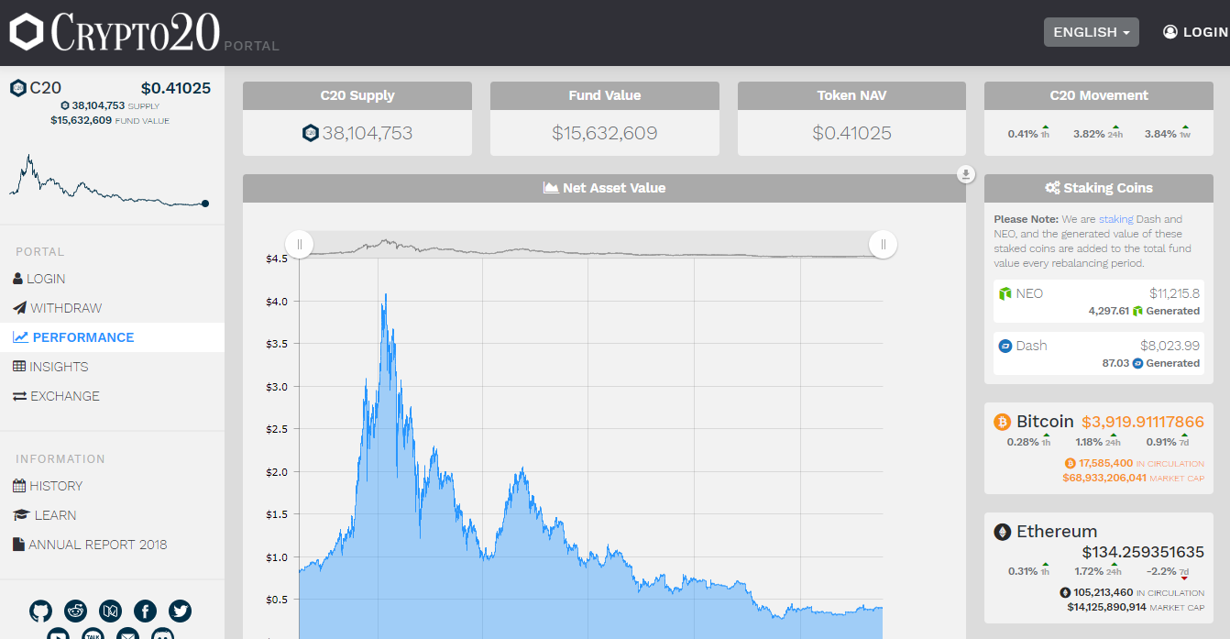
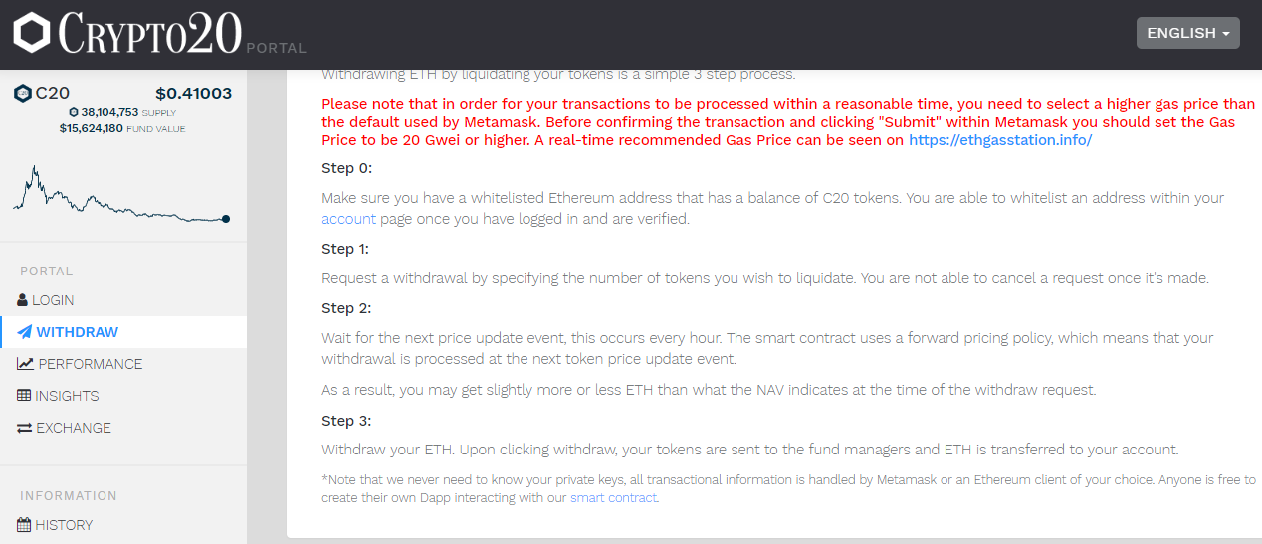
Impact for funds
Source: https://crypto20.com/en/portal/performance/

Slide 31
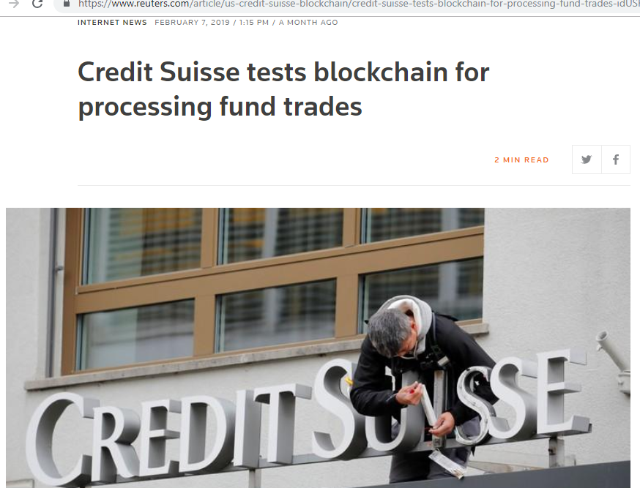
Impact for funds
Source: https://www.reuters.com/article/us-credit-suisse-blockchain/credit-suisse-tests-blockchain-for-processing-fund-trades-idUSKCN1PW2AA

Slide 32
Regulations

Slide 33
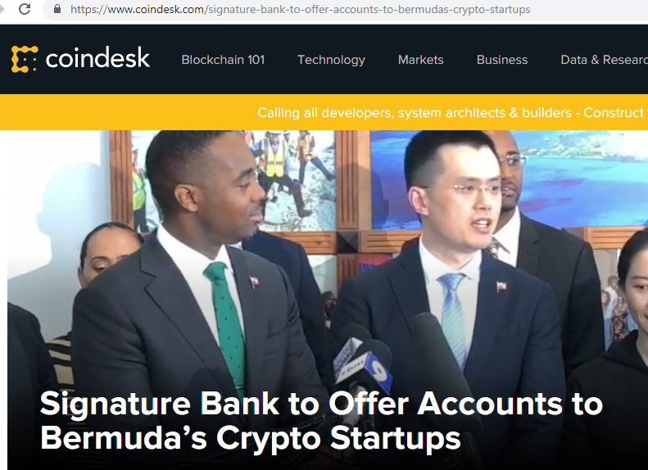
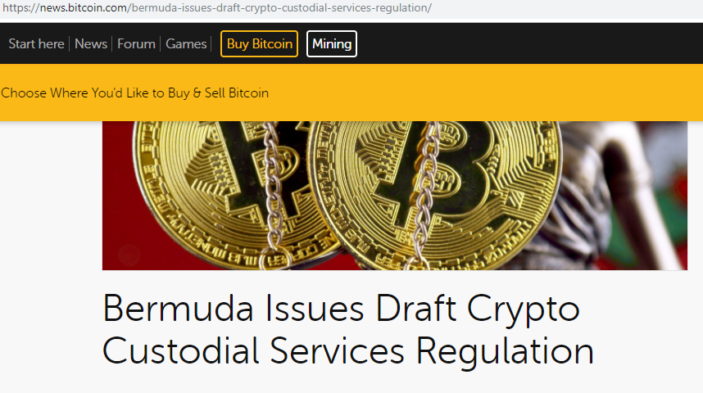
Bermuda

Slide 34
Malta

Slide 35
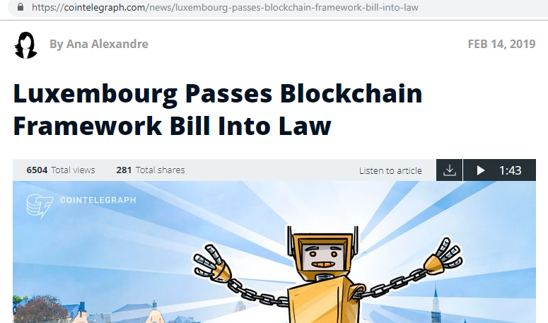
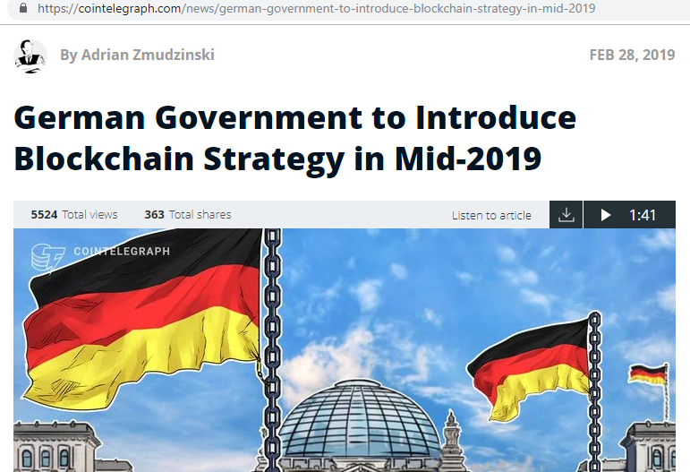
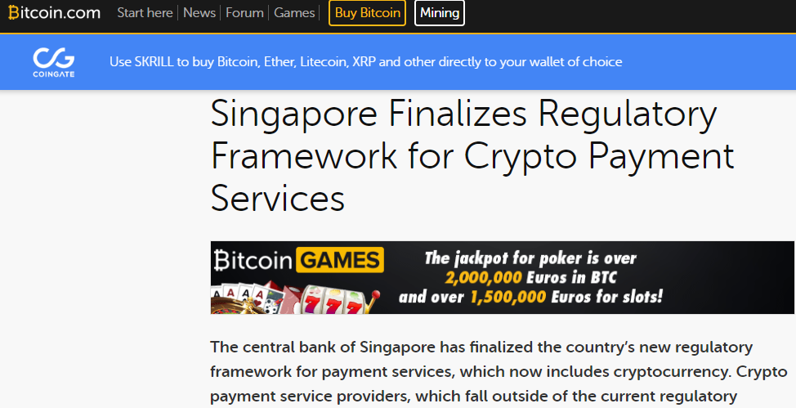
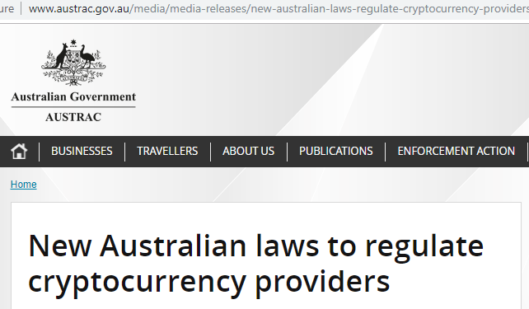
World wide

Slide 36
Financial Action Task Force (FATF)
The Financial Action Task Force (FATF) which is the global guidance body for development of AML Laws and the body that assesses all of the countries for compliance with said guidance released a draft statement today on the application of AML laws to Virtual Asset Service Providers. The proposed guidance which will be released in Final in June includes: (Updated 22 Feb 2019)
Requirement to be licenced or registered.
Requirement to conduct customer identification on all transactions over $1000
Obtain and hold required and accurate originator information and required beneficiary information as defined in INR.16, paragraph 6, on virtual asset transfers
Implementation of a fines regime for non-compliance applicable not only to the entity but the senior management and Directors.
Must be monitored by an effective regulatory body.

Slide 37
Security

Slide 38
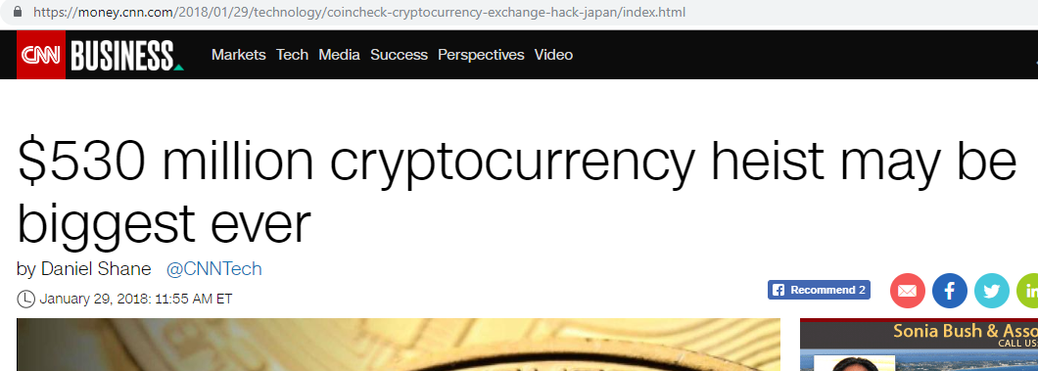
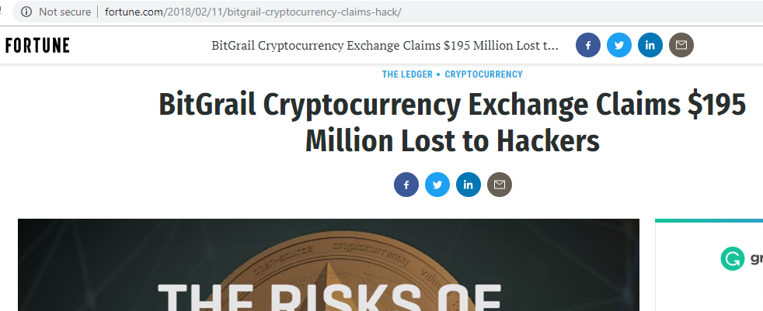
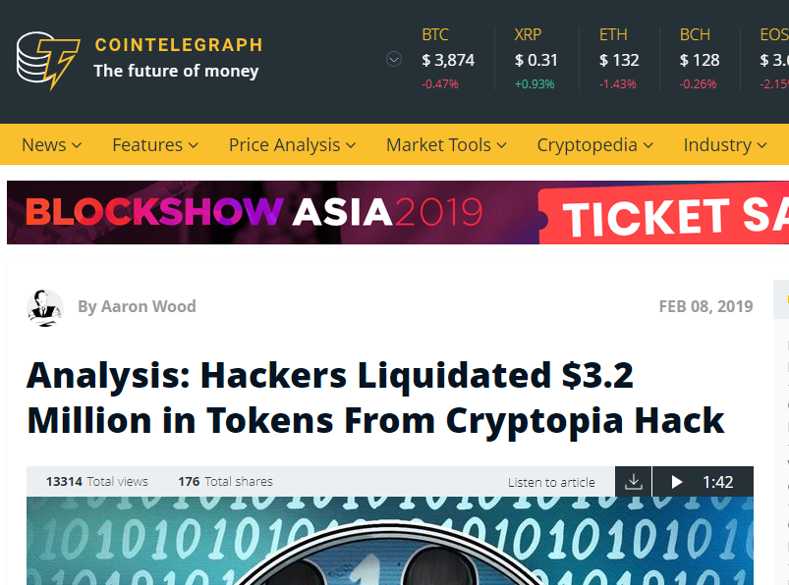
Security
Source: https://www.reuters.com/article/us-credit-suisse-blockchain/credit-suisse-tests-blockchain-for-processing-fund-trades-idUSKCN1PW2AA

Slide 39
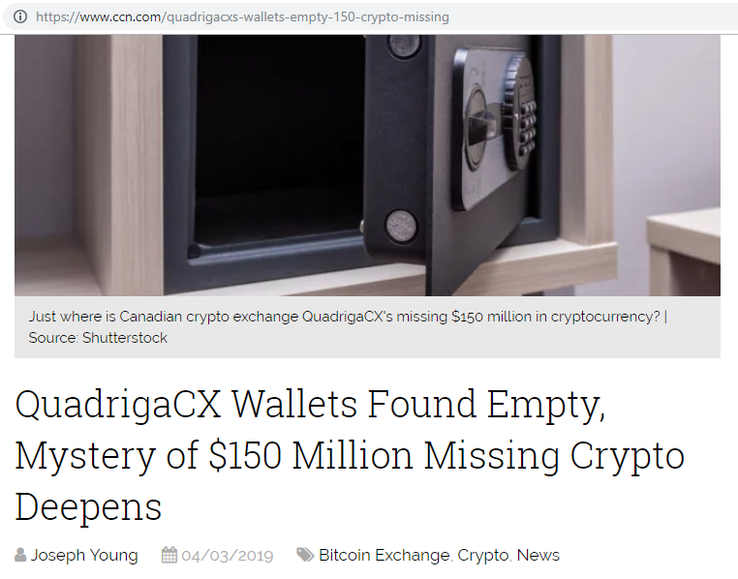
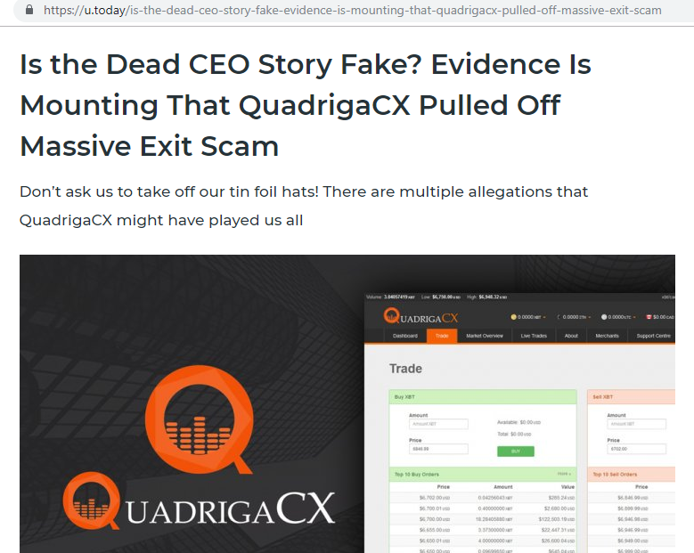
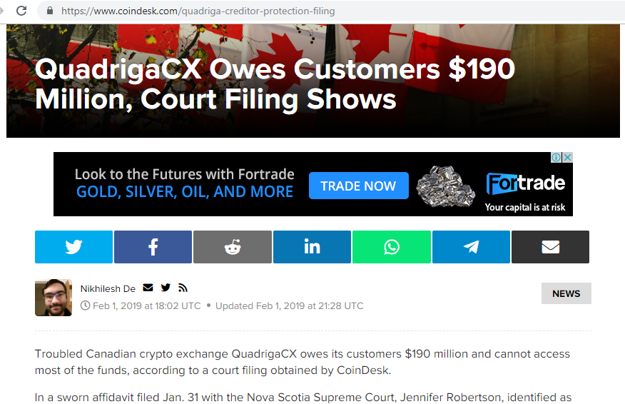
Security
Source: https://www.reuters.com/article/us-credit-suisse-blockchain/credit-suisse-tests-blockchain-for-processing-fund-trades-idUSKCN1PW2AA

Slide 40
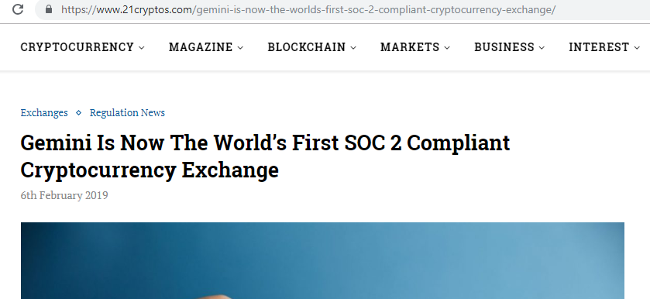
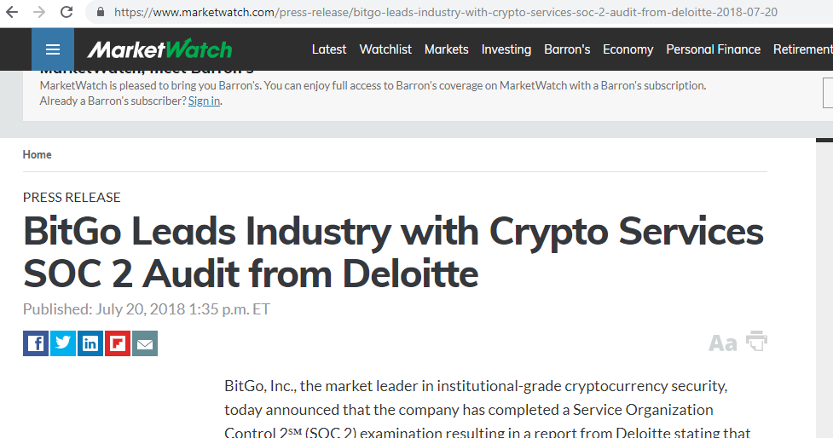
SOC’s
Source: https://www.reuters.com/article/us-credit-suisse-blockchain/credit-suisse-tests-blockchain-for-processing-fund-trades-idUSKCN1PW2AA

Slide 41
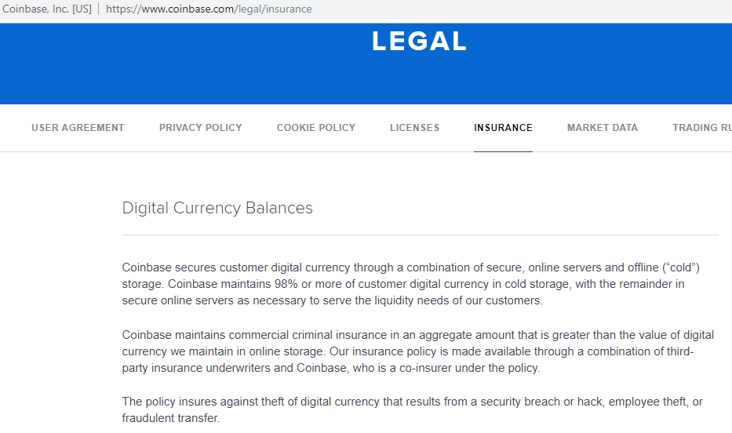
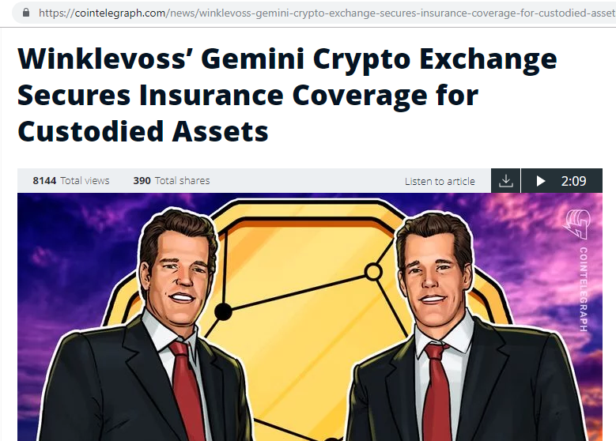
Insurance
Source: https://www.reuters.com/article/us-credit-suisse-blockchain/credit-suisse-tests-blockchain-for-processing-fund-trades-idUSKCN1PW2AA

Slide 42
The future

Slide 43
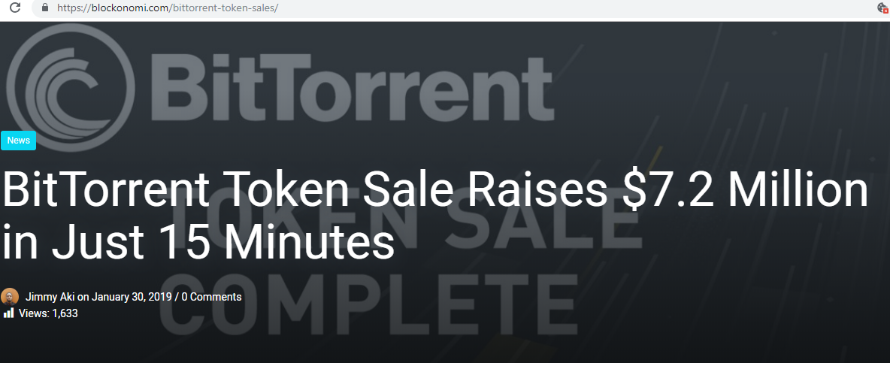
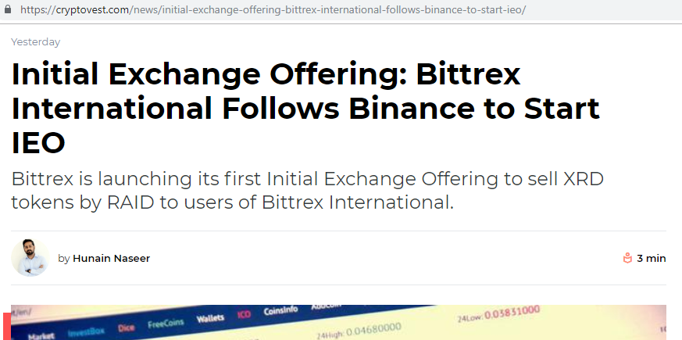
Initial Exchange Offering (IEO)
Source: https://www.reuters.com/article/us-credit-suisse-blockchain/credit-suisse-tests-blockchain-for-processing-fund-trades-idUSKCN1PW2AA

Slide 44
BACI.ky
BACI

Slide 45
Questions

Slide 46
Thank you
kpmg.ky
The information contained herein is of a general nature and is not intended to address the circumstances of any particular individual or entity. Although we endeavor to provide accurate and timely information, there can be no guarantee that such information is accurate as of the date it is received or that it will continue to be accurate in the future. No one should act on such information without appropriate professional advice after a thorough examination of the particular situation.
© 2019 KPMG, a Cayman Islands partnership and a member firm of the KPMG network of independent member firms affiliated with KPMG International Cooperative (“KPMG International”), a Swiss entity. All rights reserved.
kpmg.com/socialmedia
kpmg.com/app

